Slide 1


Strategic Insights for Parts Sales Growth
Objective: Evaluate market opportunities for parts sales in Vertical A and assess parts availability in Canada to inform strategic decisions.
Agenda:
Slide 2: Vertical A Market Opportunities (Discount Impact)
Slide 3: Canadian Market Insights (Parts Availability)
Slide 4: Strategic Recommendations
Slide 5: Thank You & Questions
Page 01

Slide 2

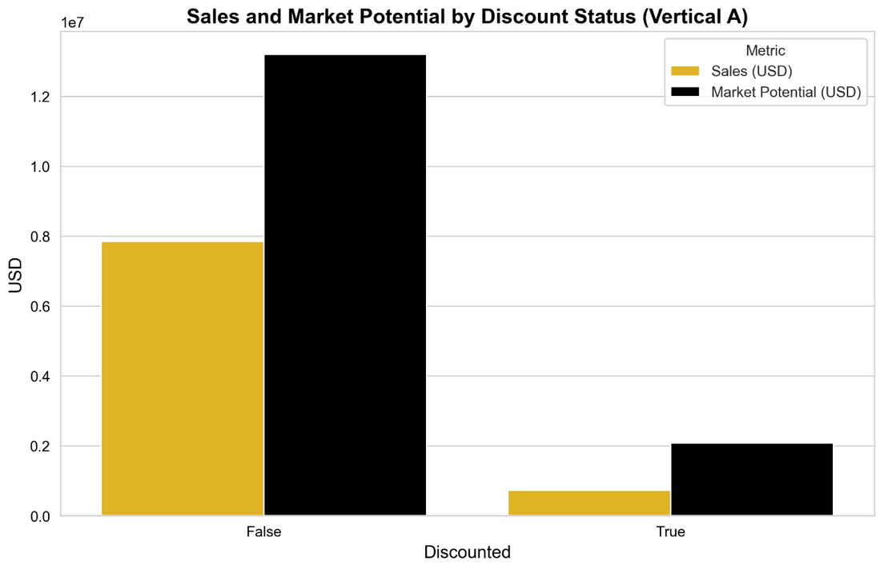
Maximizing Revenue Through Targeted Discounts
Objective: Evaluate market opportunities for parts in Vertical A, focusing on the impact of discounts.
Key Insights:
Discounts Boost Sales:
Discounted parts achieve higher average sales ($48,987 vs. $33,535 for non-discounted), but statistical analysis (p-value = 0.5008 ) confirms significant sales impact.
Market Share Gap:
Discounted parts capture lower market share (53.61% vs. 116.20%), indicating potential for optimized discount strategies to close the gap.
Top Customers Drive Opportunity:
The top 20% of customers (33) account for 78.95% of lost opportunity ($5.75M), with only 18.18% (6 customers) receiving discounts.
Page 2

Slide 3

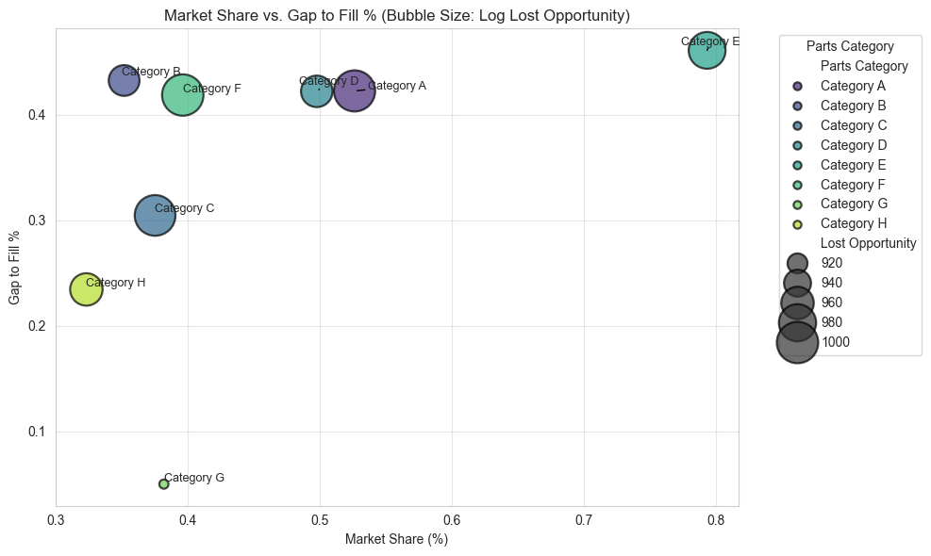
Canadian Market - Unlocking Parts Availability Opportunities
Top 3 Prioritized Insights:
High Lost Opportunity in Key Categories: Category F has the highest lost opportunity at $103,461,742,473, driven by a low market share (39.60%) and a significant gap to fill % (41.89%)
Why Critical: This category represents the largest untapped revenue potential, indicating supply constraints that limit sales capture.
Availability Gaps Limit Market Share: Categories with high Gap to Fill % (e.g., Category E: 46.13%) show a positive correlation with market share (correlation = 0.4892, p-value = 0.2186)
Why Critical: While not statistically significant (p > 0.05), the positive correlation suggests that addressing availability gaps could enhance market penetration in high-opportunity categories.
Top 20% Categories Drive Significant Opportunity: Category A alone accounts for 43.41% of total lost opportunity, highlighting a concentrated opportunity for targeted improvements
Why Critical: Focusing on a single high-impact category can yield substantial revenue gains with efficient resource allocation.
Page 3

Slide 4

Strategic Recommendations - Driving Growth at Caterpillar
OPTIMIZE DISCOUNT STRATEGIES IN VERTICAL A:
ADDRESS AVAILABILITY GAPS IN CANADA:
Target discounts to the top 20% of customers, who drive 80% of lost opportunity
Focus on Large Fleets, which show high lost opportunity based on typical trends.
Rationale: Concentrating discounts on high-value customers maximizes revenue impact.
Prioritize supply chain improvements for Category F, with a 41.89% gap to fill and $103,461,742,473 in lost opportunity
Strengthen the Sales Channel with the highest lost opportunity
Rationale: Reducing availability gaps in Category F can unlock significant revenue.
LEVERAGE PARTS CATEGORY SEGMENTATION:
Target Category F, Category A, and Category C (representing high lost opportunity: $103.5B, $100.9B, $95.2B) for tailored discount and supply chain strategies
Rationale: These categories, identified through clustering, account for the majority of lost opportunity, offering a focused approach for maximum revenue impact.
Page 4

Slide 5



I hope these data-driven insights and strategic recommendations aim to unlock significant revenue potential and enhance parts availability across Vertical A and Canadian markets. I’m eager to contribute to Caterpillar’s success by implementing these strategies with REAL DATA.
Thank
You.
-Monish Nallagondalla,
B.E - Mechanical Engineering |
MSc - Data Science , UK
Questions or feedback?
+919538809196
nsmonish@gmail.com
Page 5

